Slide 1

Selling Value
How Sales & Revenue Create Impact
Brian Stevens Chief Revenue Officer
Revenue isn't just a department—it is the outcome of solving meaningful problems for customers.
Today's objective:
• Learn how businesses create revenue
• Explore transferable career skills
• Apply the concepts in a team activity

Slide 2
Agenda
Session Format (1 Hour)
• 5–10 min — Introduction, background & role
• 15–20 min — Core lessons from leading Revenue
• 15–20 min — Team activity
• 5–10 min — Reflection & Q&A
Introduction
Core Lessons
Activity
Reflection & Q&A

Slide 3
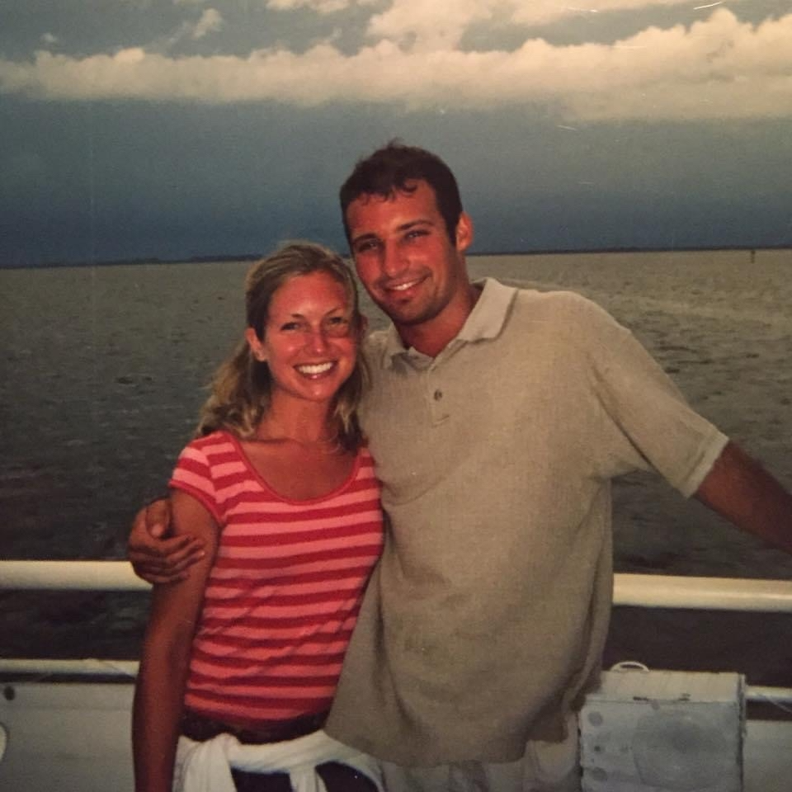
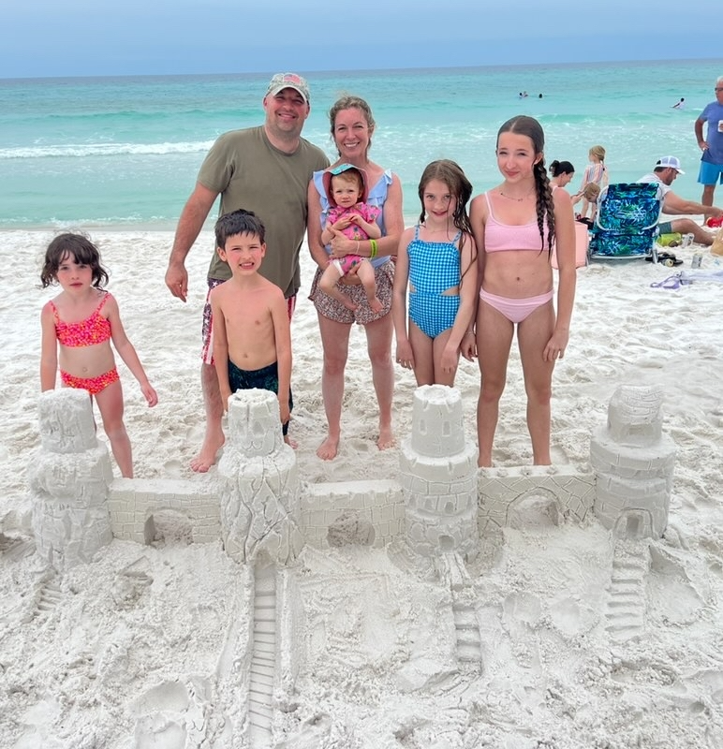
About Me
Wife Heather, and 5 kids (Keira 14, Autumn 10, Nolan 8, Hannah 5, Sophie 1 and we live in Brighton, MI kids go to Brighton Area Schools). Go Bulldogs!
Spend time with family and friends at our cottage on Harsens Island in Michigan, and we stay busy with their school and sports (two oldest daughters are competitive gymnasts, and my son Nolan plays basketball, soccer, and football)-I’m an assistant coach on his football team)
Brian Stevens, born in 1981 in Marine City, MI
Undergrad: Central Michigan University MBA: Northwood University Absolutely love working here at Evisions!
Played Football, Basketball, Baseball for Marine City (All Conference in Football, and Team MVP, All Conference, All Region and Detroit News All Metro East team in Baseball). Captain of Football and Baseball teams my Senior year (and Junior year also for Baseball)
Introduction
Core Lessons
Activity
Reflection & Q&A

Slide 4
My Journey
My path wasn’t linear and failure was an excellent teacher
Started at Enterprise Rent a Car and moved into Commercial Real Estate
Failed as a high-level leasing Executive at Taubman Company
• Was recruited into a Software Sales role at iDashboards. Used the same intense work ethic but added curiosity (not just working harder, but also smarter)
• Came to Evisions and hit the ground running as a successful Account Executive
Grinded as a highly disciplined sales rep and broke the Michigan record for most Toshiba copiers sold in anyone’s first year (hundreds of reps)
Went from Mid Six Figure Executive leasing role at 28 at Taubman to literally selling copier machines on 8 Mile road in Detroit
In 2017 I earned the opportunity to lead the sales team as Vice President of Sales (but this time I dedicated myself to being a servant leader that put the team first vs. my own ambitions)
That led to eventually becoming VP of Sales & Marketing which led to earning the role of Chief Revenue Officer in 2021

Slide 5
The Revenue Engine
Evisions creates revenue through: New Software Bookings (Argos, FormFusion, IntelleCheck, Data Agent, Accelerators) Recurring Revenue (renewing current clients at a high Retention Rate) Professional Services Bookings and Delivery Partnership Sales
Revenue is created when every team works together.
Marketing creates awareness.
Sales uncovers needs.
Customer Success delivers value.
Renewals and expansion create long-term growth.

Slide 6
Lesson 1
Customers buy outcomes—not products.
Customers rarely buy software.
They buy:
• Time savings
• Better decisions
• Less risk
• Improved outcomes

Slide 7
"Curiosity builds trust."
The best salespeople don't have the best pitches.
They ask the best questions.
Curiosity → Understanding → Trust → Value

Slide 8
Lesson 3
Your reputation compounds over time.
Trust is built by:
• Listening
• Following through
• Being honest
• Putting customers first
Listen

Slide 9
Lesson 4
Who here thinks they’ll never be in sales in their career?
Whether you're an engineer, analyst, marketer or leader—you'll spend your career influencing people.
Ideas only matter when others believe in them.
Influence

Slide 10
What I Hire For
Curiosity
Coachability ty
Ownership
Integrity

Slide 11
Interactive Challenge
Challenge:
In teams, imagine Evisions launches a new AI advising solution.
Define:
• Your customer
• Their biggest problem
• The value proposition
• Deliver a 60-second pitch

Slide 12
Learn. Build Trust. Solve Problems.
Three questions:
• What surprised you today?
• Which skill will you intentionally develop?
• How can you create value this summer?
Questions?

